Slide 1





TECHFEST
SMART OBJECT DETECTION AND TRACKING SYSTEM
Guided by:
Presented by:
Dr.Kiran Wakchaure
Visionary Minds

Slide 2





VISIONARY MINDS
Soham Kadu
Saish Shinde
Utkarsh Bhosale
Sejal Shinde
Team Leader
Team Member
Team Member
Team Member

Slide 3


PROBLEM STATEMENT
The goal of this project is to Develop a real-time system to automatically detect and classify objects within images or video streams with high accuracy, efficiency, identifying multiple objects in various environments.
Why is real-time object detection and tracking critical?
Safety
Efficiency
User Experience
Real-time Decisions
Accuracy

Slide 4

How YOLO Model Works
Input Image Processing
Feature Extraction
Grid Division
Bounding Box Predictions
Class Prediction
Final Output

Slide 5

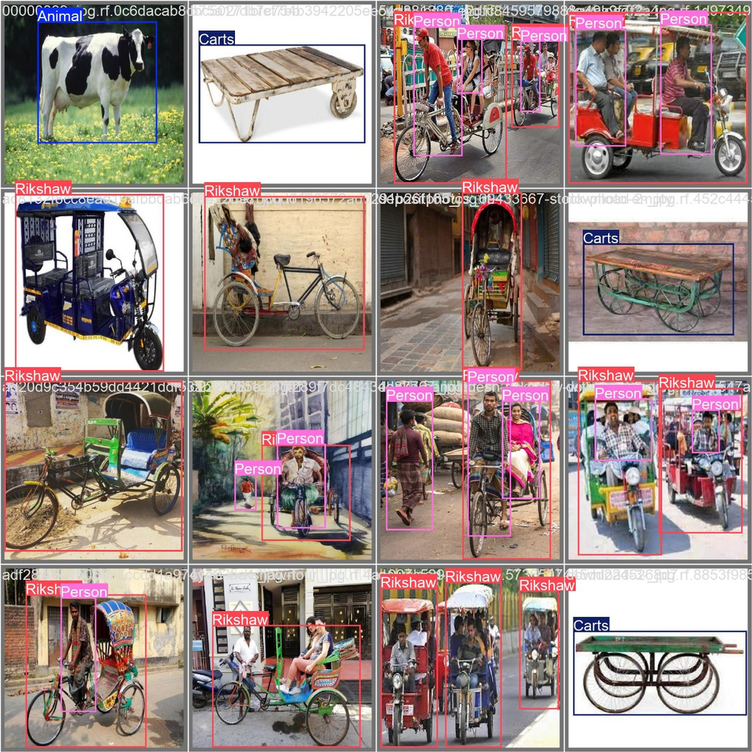
KEY FEATURES
Real-Time Performance:
Process live video streams efficiently.
Multi-Class Detection:
Detect and track diverse objects simultaneously.
Robust Tracking:
Handle occlusions and re-identification effectively.
Scalability:
Adaptable to various use cases like drones, vehicles, and surveillance systems.

Slide 6
Results

Slide 7
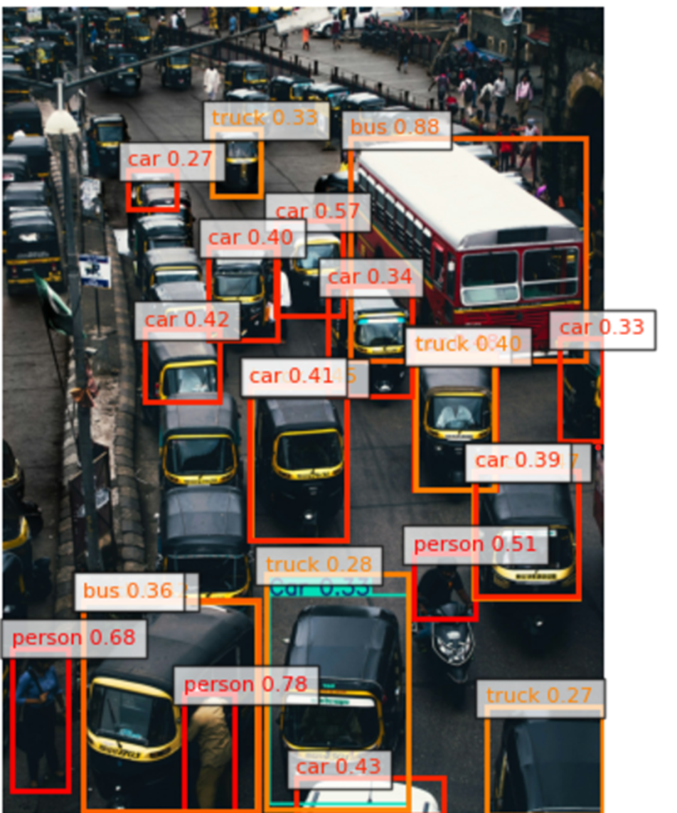
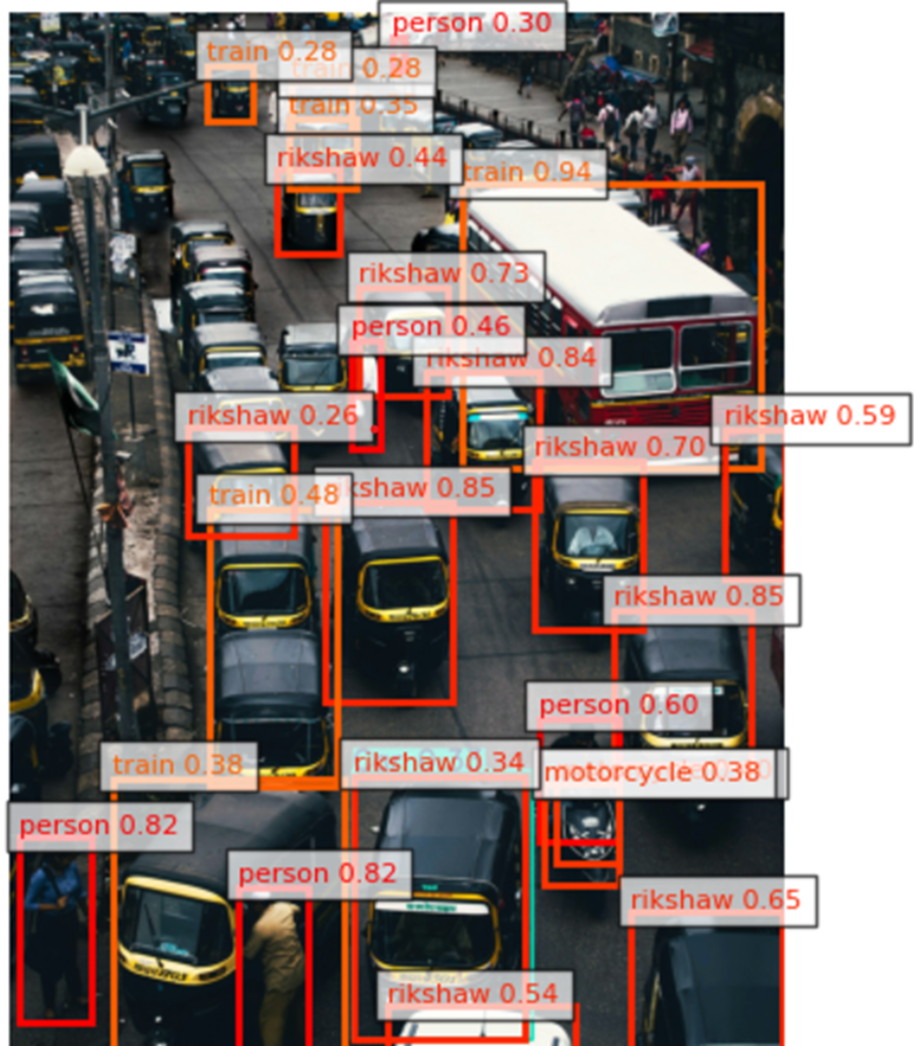

Slide 8
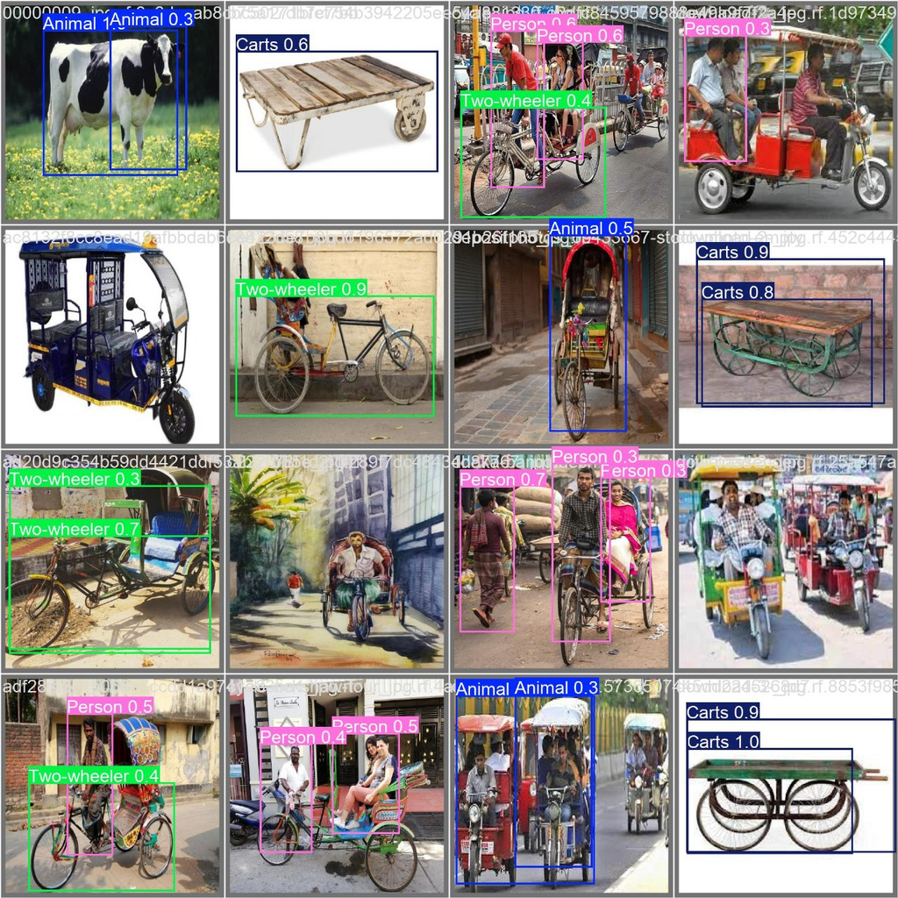
Yolov8n
Trained

Slide 9


Slide 10
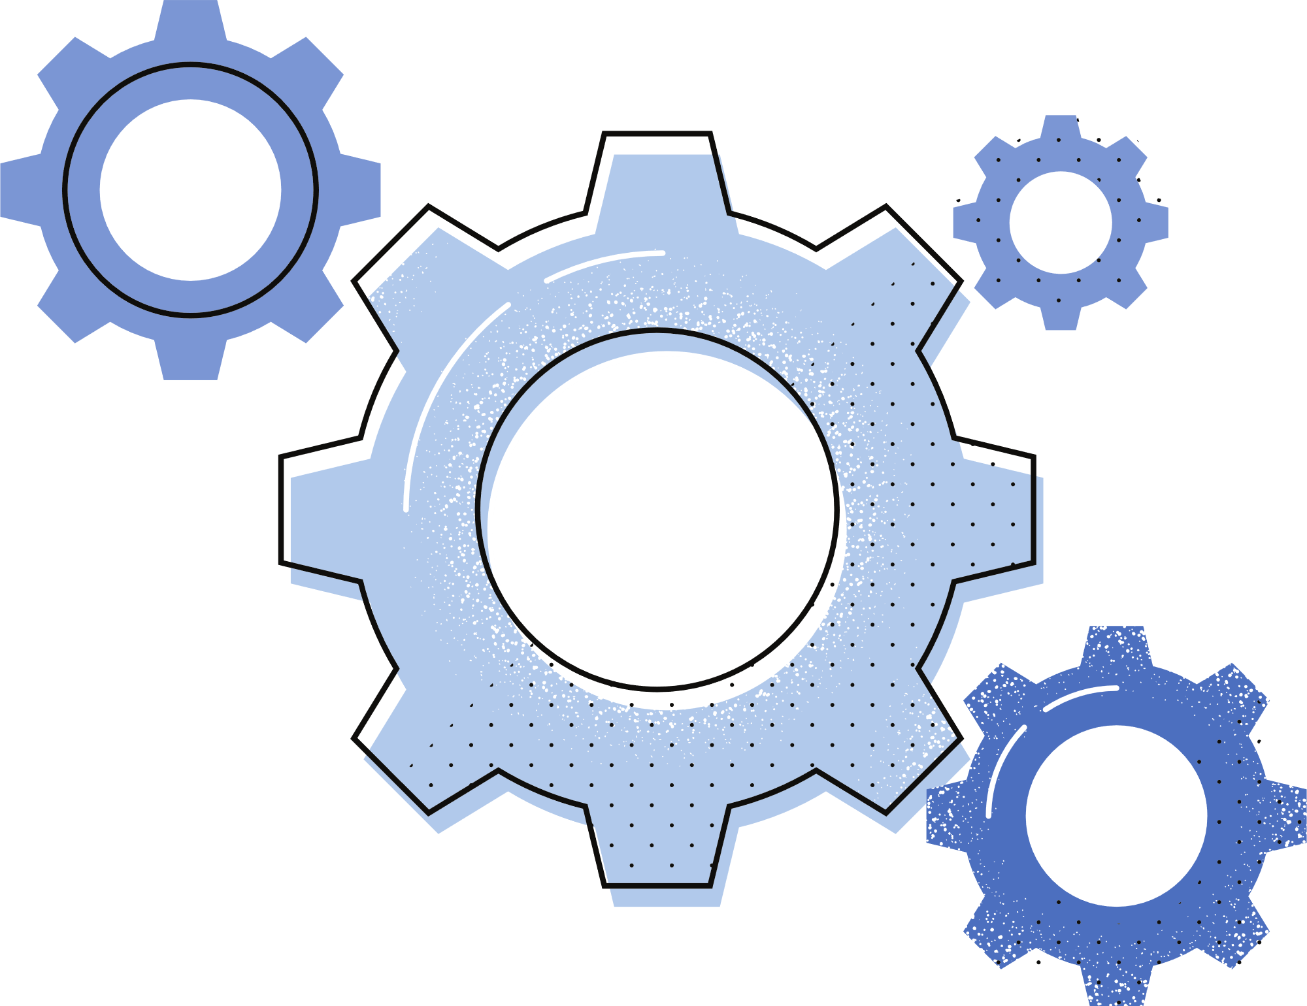

PROJECT OBJECTIVE
Develop a robust system that combines real-time object detection and seamless tracking.
Ensure high accuracy, adaptability to different environments, and scalability for future enhancements.
Optimize the Model for Real-Time Performance

Slide 11


Refers to datasets or real-world data from sensors and cameras.
SOURCES
DATA COLLECTION
ANNOTATION TOOLS
Tools like LabelImg or VoTT for labeling images.
AUGMENTATION
Techniques like flipping, cropping, and brightness adjustments
to enhance data variety.
PREPROCESSING
NORMALIZATION
Standardizing data formats and scaling pixel values.
YOLO
Efficient real-time detection model.
MODEL SELECTION
OBJECT DETECTION
SSD
Single Shot Detector for faster inference.
HYPERPARAMETERS
Learning rate, batch size, number of epochs, etc.
TRAINING
GPU/TPU
Accelerated hardware for faster training.
IOU
Measures overlap between predicted and actual bounding boxes.
EVALUATION
MAP
Evaluates precision and recall across classes.
TUNING
Adjusting hyperparameters for better performance.
OPTIMIZATION
QUANTIZATION
Reducing precision for deployment.
DEPLOYMENT
EDGE DEVICES
Raspberry Pi, ESP32, and other lightweight systems.
CLOUD PLATFORMS
AWS, Google Cloud, or Azure for scalable processing.

Slide 12
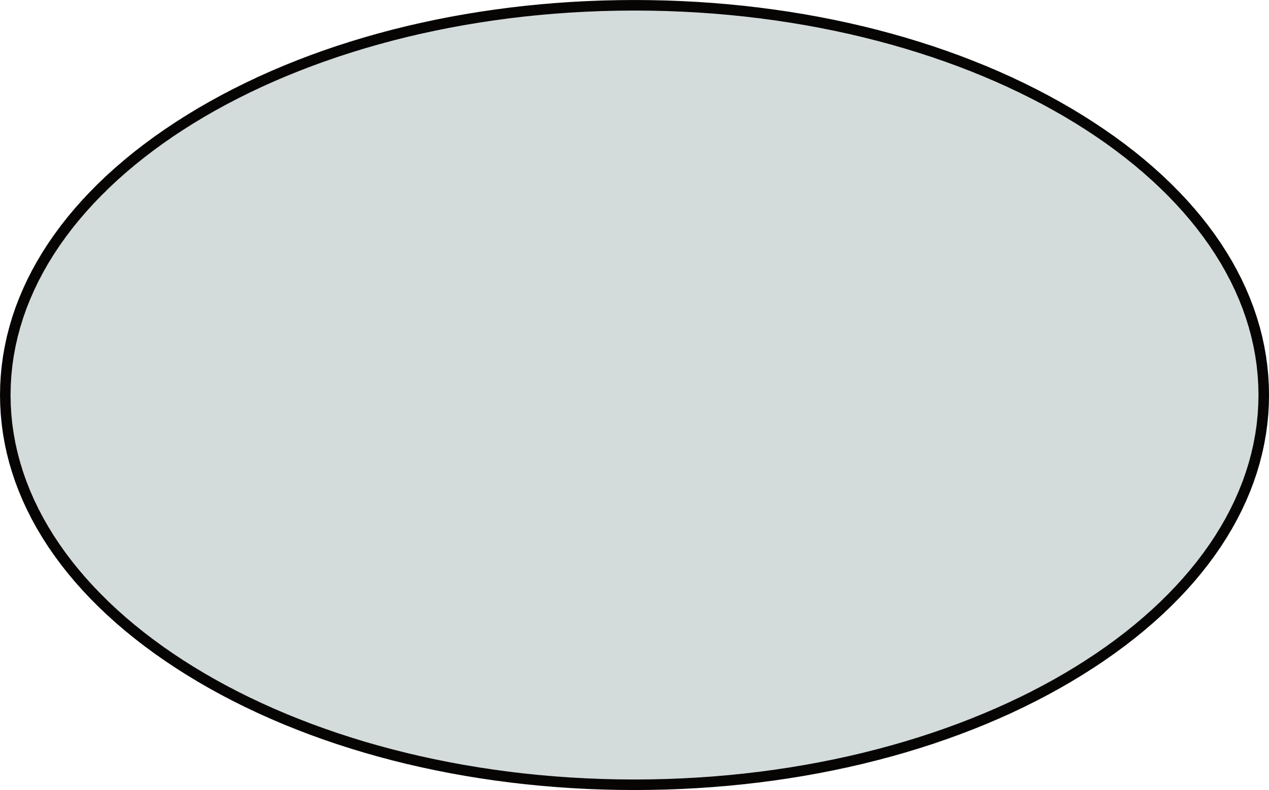
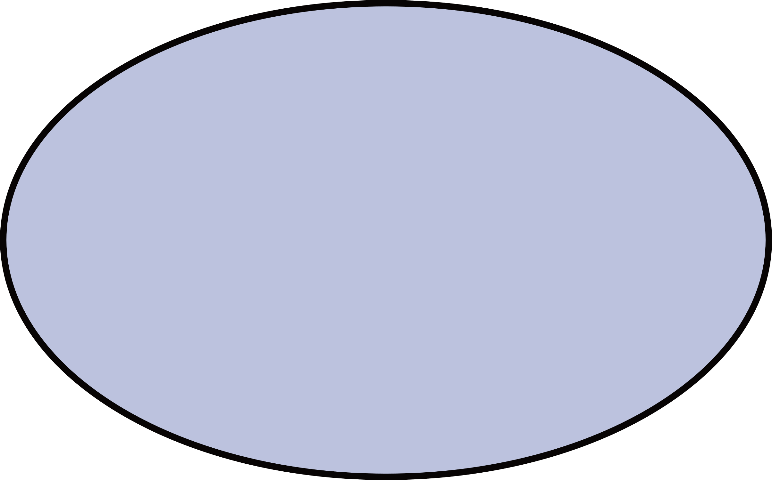

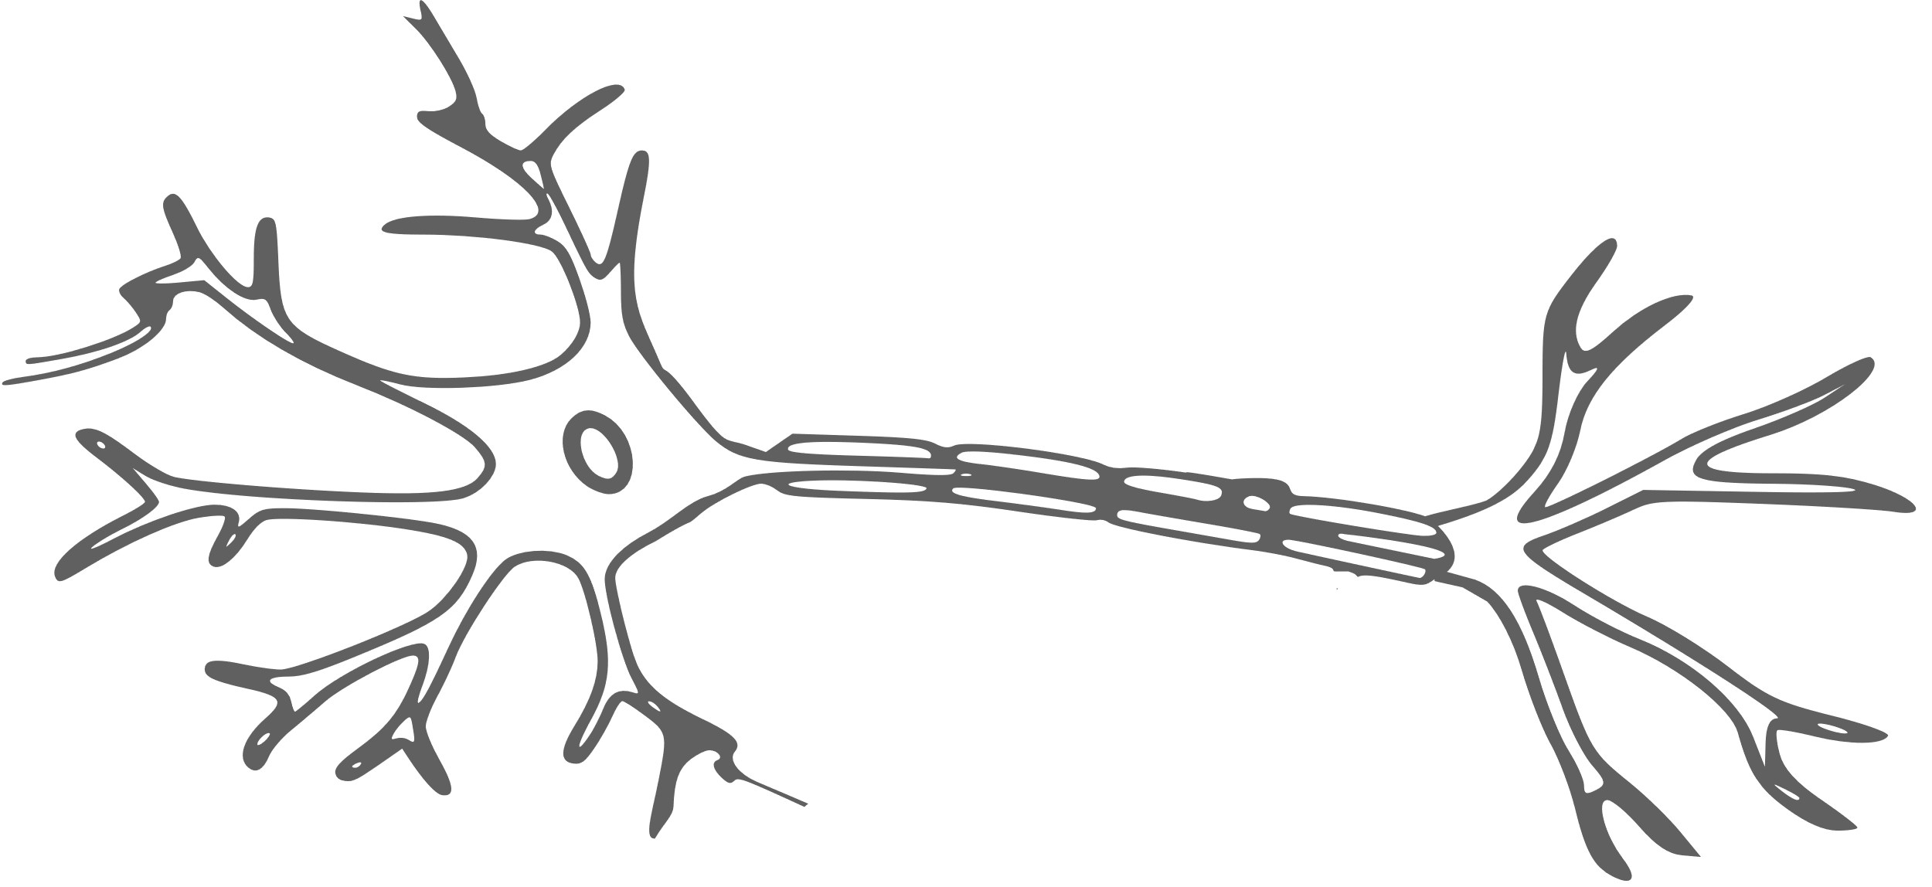
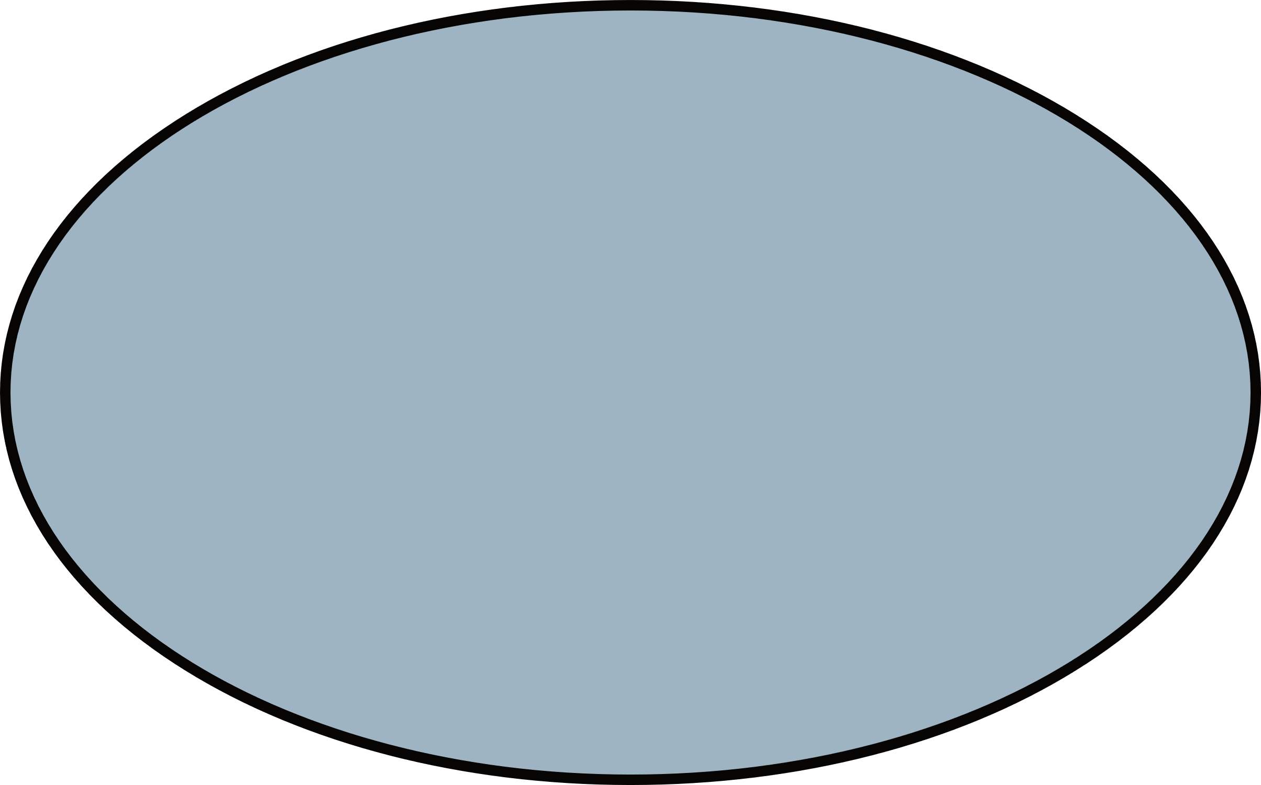
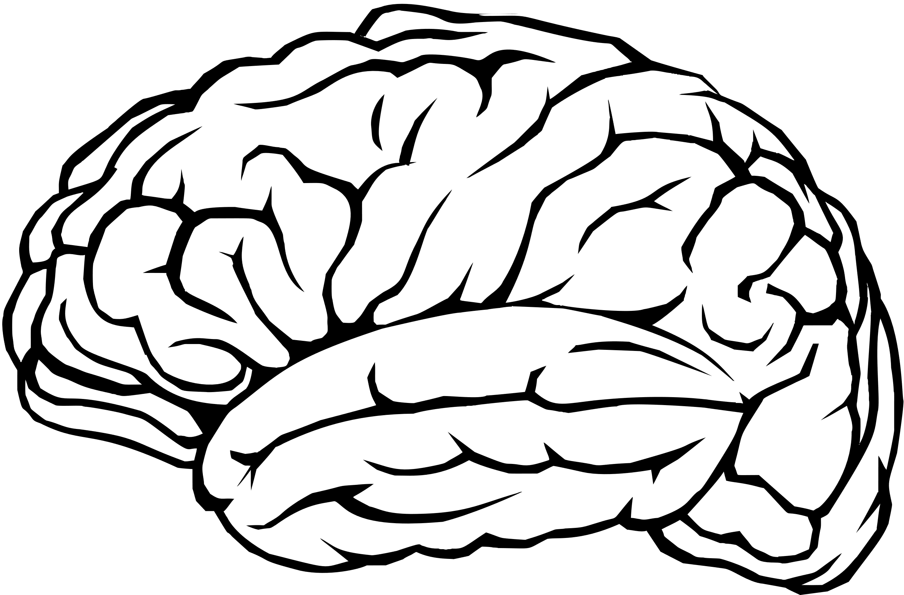
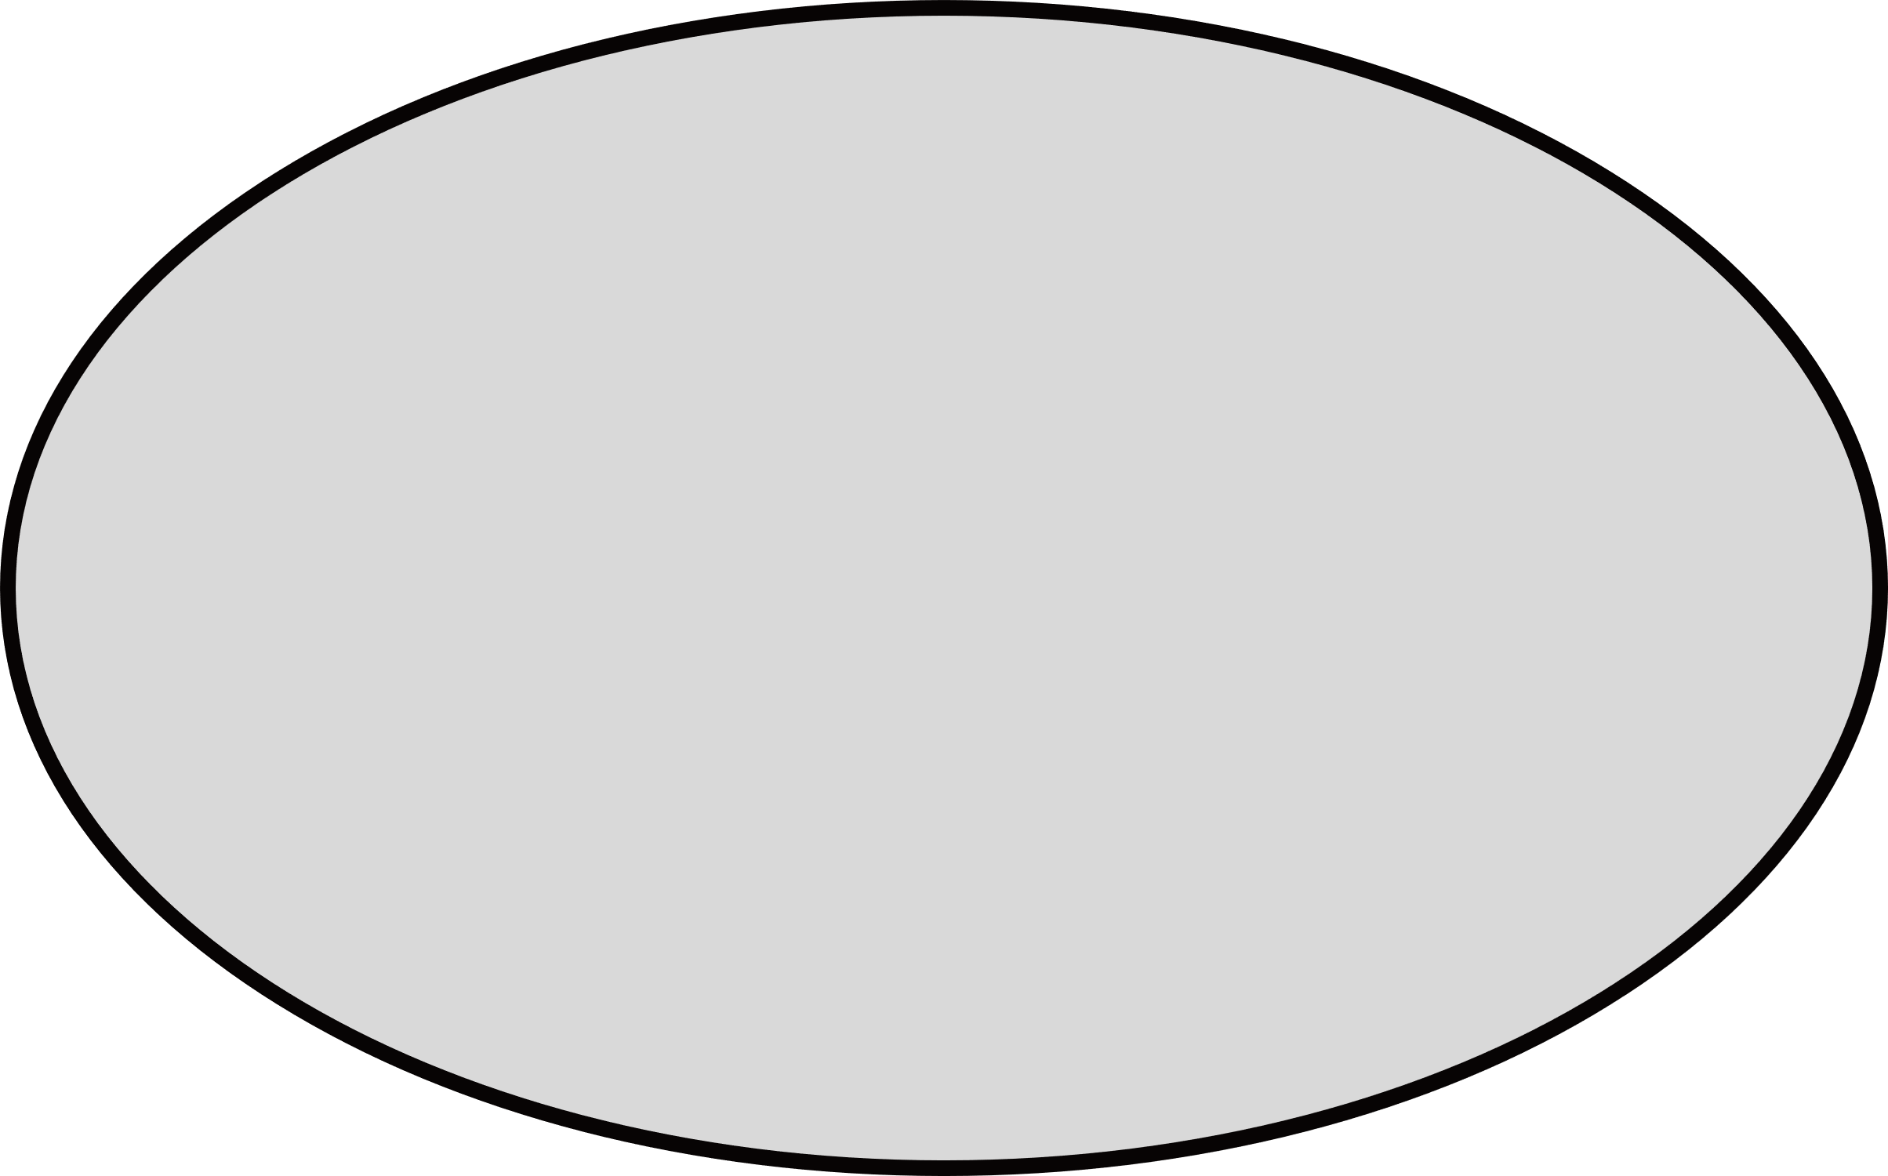
AI/ML Engineers
Data Scientists
Software Developers
Retailers
Autonomous Vehicles
Healthcare
Deep Learning
Transfer Learning
Edge AI
TensorFlow
PyTorch
OpenCV
Labeled Data
Synthetic Data
Real-Time Data
End Users
Machine
Learning & AI
Frameworks &
Libraries
Developers/
Engineers
Data &
Dataset
Business
Stakeholder
Users
Technology
Multi-Class
Detection
Product Managers
Executives
Operations Teams
Innovation
Solutions
Recognizing multiple object types in a single image
Ability to detect rare or custom objects
Adaptability to different industries
Key Features
Edge
Computing
Explainable
AI (XAI)
On-device processing
Fast response times
Lower bandwidth requirements
AI-Driven
Insights
Real-Time
Detection
Accuracy
Predictive maintenance
Smart analytics
Behavior recognition
Low latency
Fast inference
High throughput
High precision
Robust under diverse conditions
High recall
Transparent decision-making
Debugging models
Building trust with users

Slide 13
TECHNICAL
OVERVIEW:
Core Technologies:
YOLOv8:
Real-time object detection
OpenCV:
For image processing and visualization.
Flowchart/Diagram:
A visual workflow showcasing:
Input → Detection (YOLO) → Tracking
→ Output

Slide 14

IMPLEMENTATION DETAILS
Hardware
Setup:
Programming
Stack:
Optimization Techniques:
GPU for accelerated performance (mention specifics, if available).
Python
Torch
OpenCV
CUDA support, pre-trained weights, and model fine-tuning.

Slide 15

DEMONSTRATION/RESULTS
Visuals:
Screenshots or clips of the system in action.
Performance Metrics:
Accuracy, Precision, Recall.
FPS (Frames Per Second) for real-time capabilities.
Comparison Graphs:
Benchmark results against alternative solutions.

Slide 16
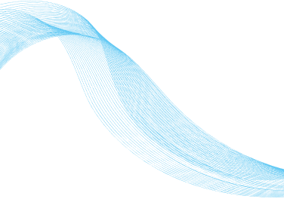



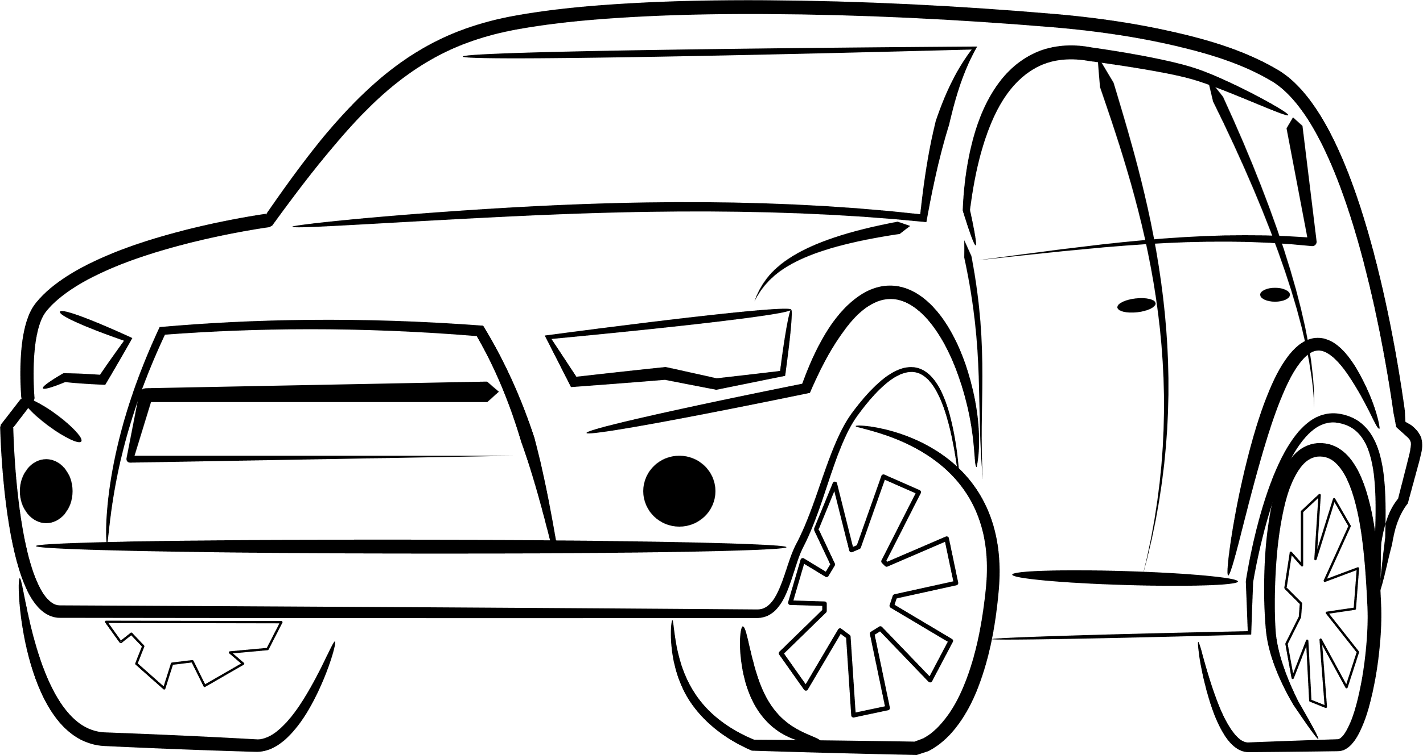

REAL-WORLD APPLICATIONS
SURVEILLANCE:
RETAIL ANALYTICS:
Enhancing security with intelligent tracking.
Customer behavior and queue management.
AUTONOMOUS VEHICLES:
CROWD MONITORING:
Monitoring objects and preventing collisions.
Tracking individuals in dense environments.

Slide 17
REFERENCES
https://www.deeplearning.ai/short-courses/introduction-to-on-device-ai/
https://www.mdpi.com/2079-9292/13/15/3033
https://ieeexplore.ieee.org/abstract/document/10508365/
https://www.mdpi.com/2079-9292/13/12/2250

Slide 18
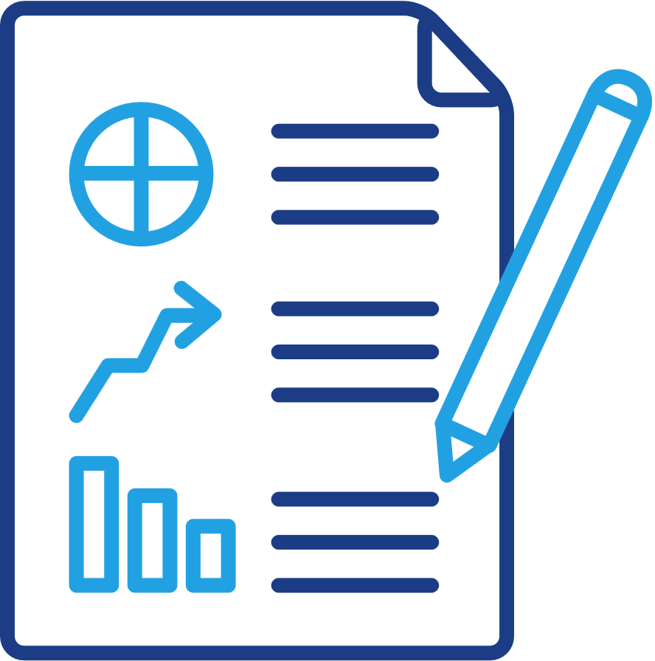
CHALLENGES AND SOLUTIONS
Handling occlusions.
Real-time optimization issues.
Adapting to varying lighting conditions.
2.Solutions Implemented:
GPU utilization
Data augmentation
Algorithmic improvements.

Slide 19

FUTURE SCOPE
Integration with IoT for smart devices.
Adding predictive analytics for object behavior forecasting.
Scaling the system to cloud platforms for wider applications.
Exploring more efficient models for enhanced performance.

Slide 20

CONCLUSION
The Smart Object Detection and Tracking System successfully leverages computer vision and machine learning to accurately detect and track objects in real-time.
This project showcases the potential of AI-driven technologies in transforming industries and improving lives.

Slide 21

TECHFEST
THANK
YOU

